Slide 1
Used Car Price Predictions
on eBay
Team 6

Slide 2
Our Team
Chris
Chang
Ting-Hsuan Chen
Haiyuan Zhang
U98764222
U51060396
U68804194
cchang72@bu.edu
aliciac@bu.edu
haz155@bu.edu
XX DRIVER LICENSE XX
XX DRIVER LICENSE XX
XX DRIVER LICENSE XX
Mekhal
Raj R
Yifang (Harry) He
Mohammed Al Qenae
U31160630
U94086175
U04709532
mekhal@bu.edu
yifanghe@bu.edu
alqenae@bu.edu
XX DRIVER LICENSE XX
XX DRIVER LICENSE XX
XX DRIVER LICENSE XX

Slide 3
Table of Contents
01
02
03
04
Intro to Problem
EDA
Describing problem, the bigger picture, and dataset
Exploring features and correlation among variables
ML Models
Conclusion
Comparing ML models to see which one(s) performed best
Summarizing results, challenges, and lessons we learned that can be put to practice

Slide 4

01
Intro to Problem

Slide 5
Objective /
Bigger Picture
To predict listing price of used cars on eBay based on predictors such as vehicle type, gearbox, fuel type, and kilometers on car.
To provide insight/guidance for future buyers and sellers on the prices they should list or bid on eBay for used cars.

Slide 6
Our Dataset
Data Source
Columns
Rows
Variable Types
https://towardsdatascience.com/predicting-the-price-of-used-cars-891d13faf3fc
Character, Integer, Other
19
50000

Slide 7
The features of our dataset
Price | Vehicle Type | Year of Registration | Gearbox | Power PS
Model | Kilometer | Fuel Type | Brand | Not Repaired Damage

Slide 8
Data Cleaning
3rd
1st
2nd
Filtered year of registration and price outliers
Dropped
Date Crawled, Seller, Offer Type, abtest, Month of Registration, Date Created, Postal Code, Last Seen, Name
Removed NAs, zeroes, and blank spaces

Slide 9
02
Exploratory Data Analysis

Slide 10
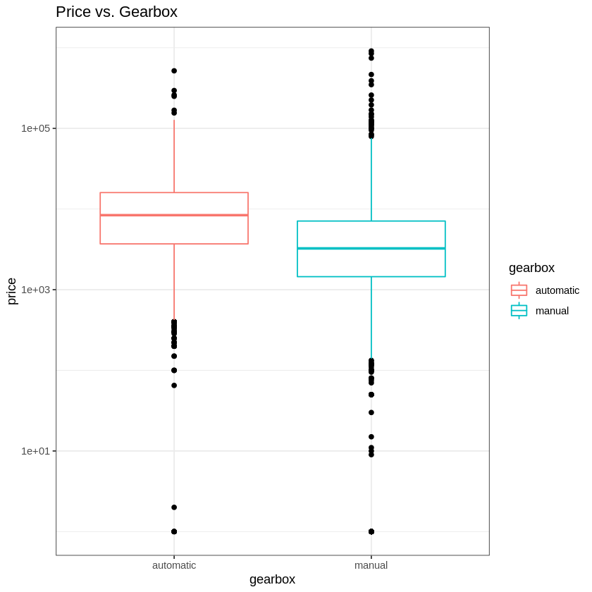
Gearbox
Price vs. Gearbox
Notes:
As we can see from the boxplot for Price vs. Gearbox, vehicles with automatic transmission have higher median compared to vehicles with manual transmission. However, manual cars have higher variance in price. This is perhaps because manual vehicles can range from exotic sport cars to very cheap cars.

Slide 11
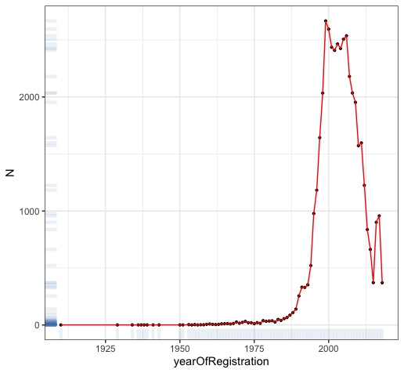
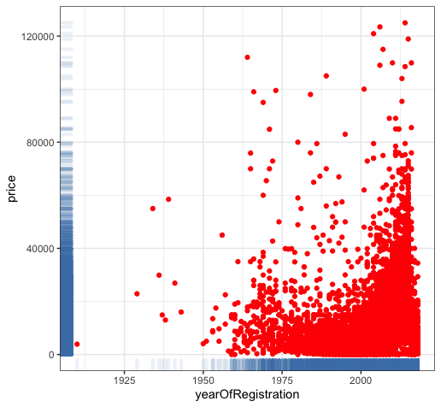
Year of Registration
Counts of cars registered for each year
Relationship between price and registration year

Slide 12
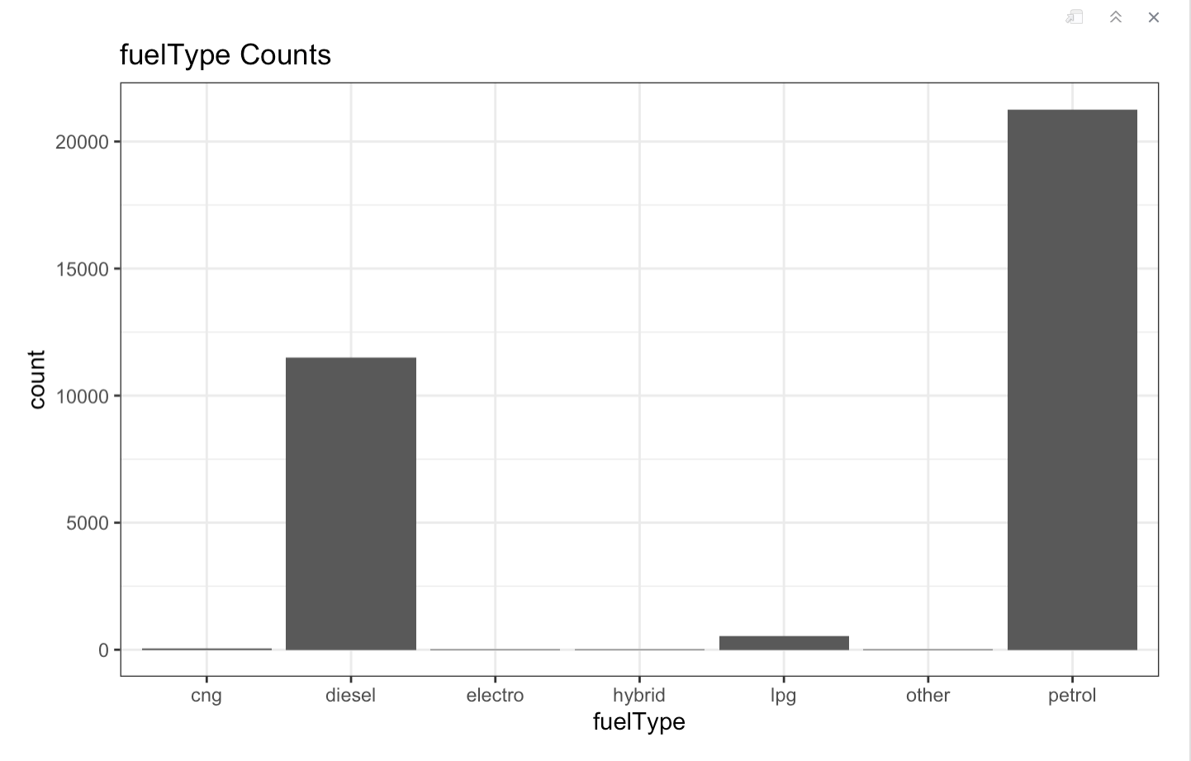
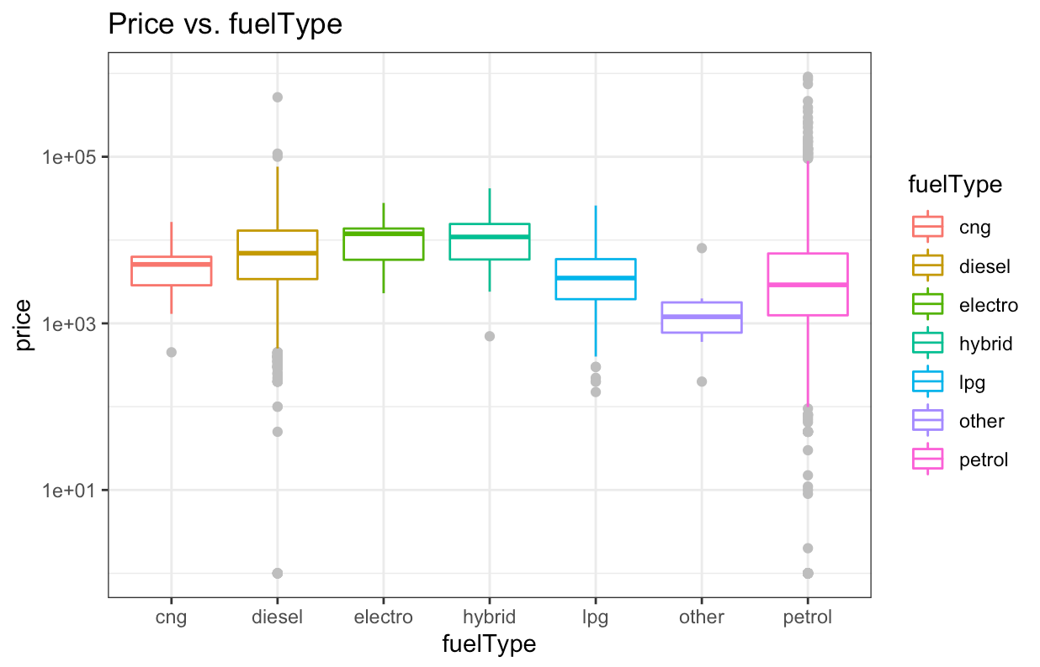
Fuel Type
Count of Fuel Type
Price vs. Fuel Type
Notes:
As can be seen from above, the fuel type of most used cars is petrol. From the box plot, we can also see that used cars that used petrol as fuel have a higher range in price. Because cars using petrol can range from small cars to luxury sports cars.

Slide 13
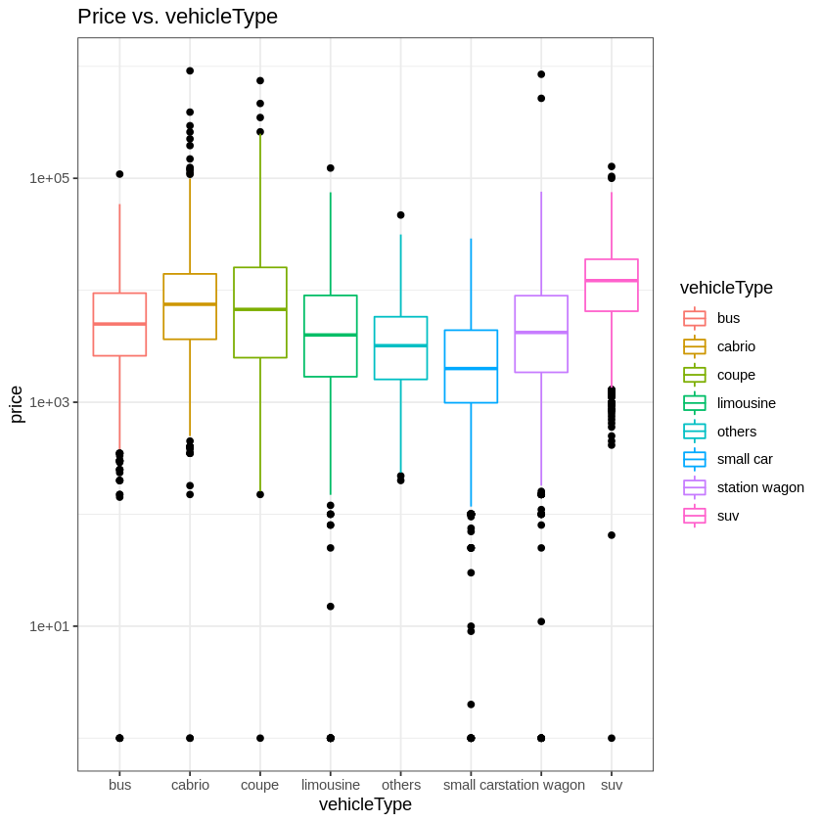
Vehicle Type
Vehicle Type vs. Price
Notes:
As we can see from the boxplot for Price vs. Vehicle Type, SUVs have higher median price when compared to other vehicles. As expected, Small Cars have the lowest median of all types of vehicles and Coupe cars have higher range of price as they can range up to high end sports cars.

Slide 14
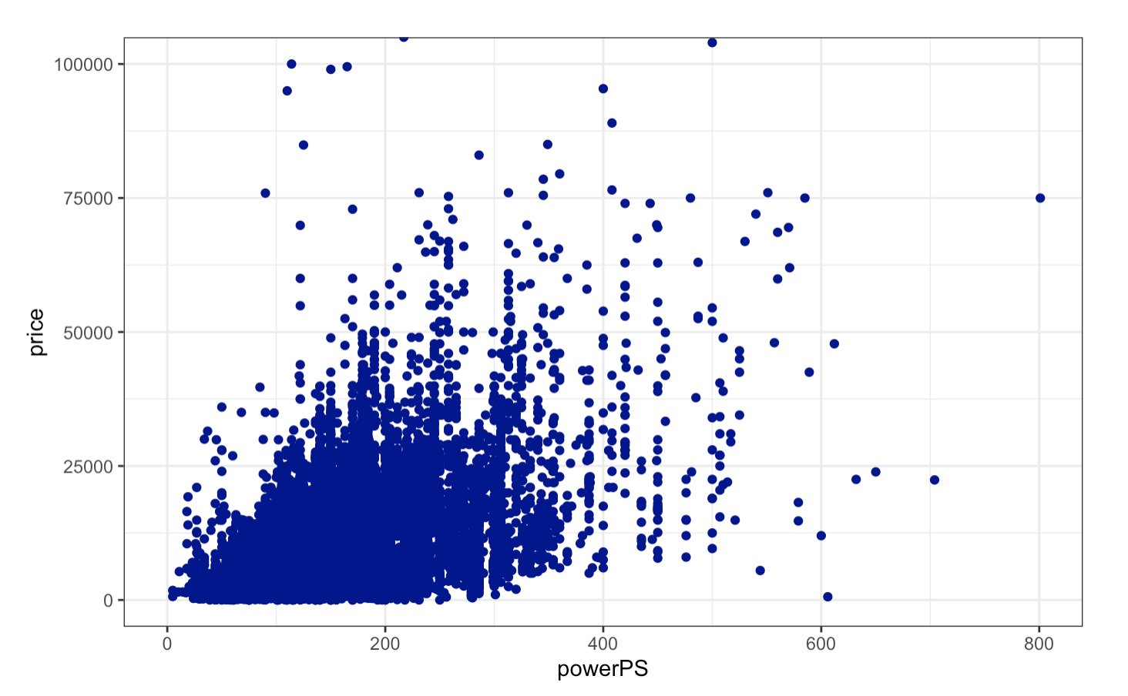
PowerPS
PowerPS vs. Price
Notes:
#Interpretation
1. From the plot we notice that price is positively correlated with powerPS.
2. Higher powerPS leads to higher listing price, but most were list within 400 range
3. Lower powerPS vehicles tend to have more competitive listing than higher powerPS vehicles.

Slide 15
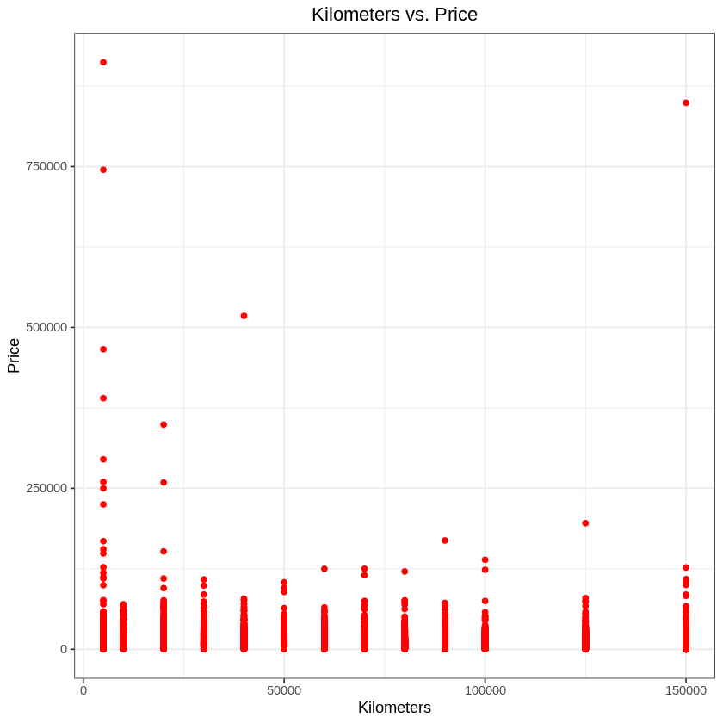
Kilometers
KM vs. Price
Notes:
There is a slight negative relationship between kilometers and price, as kilometers increase price tend to decrease. This makes sense as people prefer cars with lower kilometers driven.

Slide 16
03
Machine Learning
Models

Slide 17
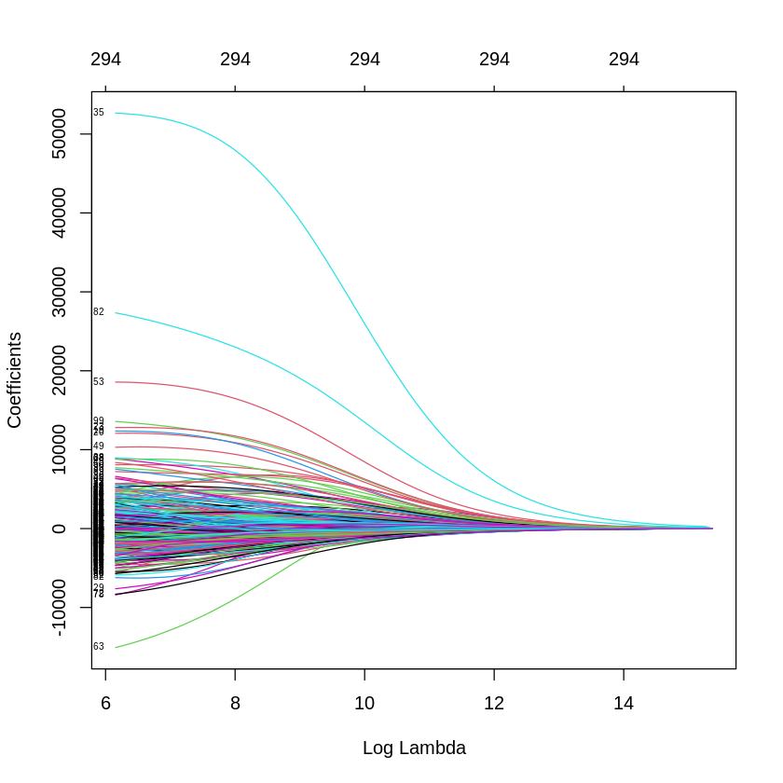
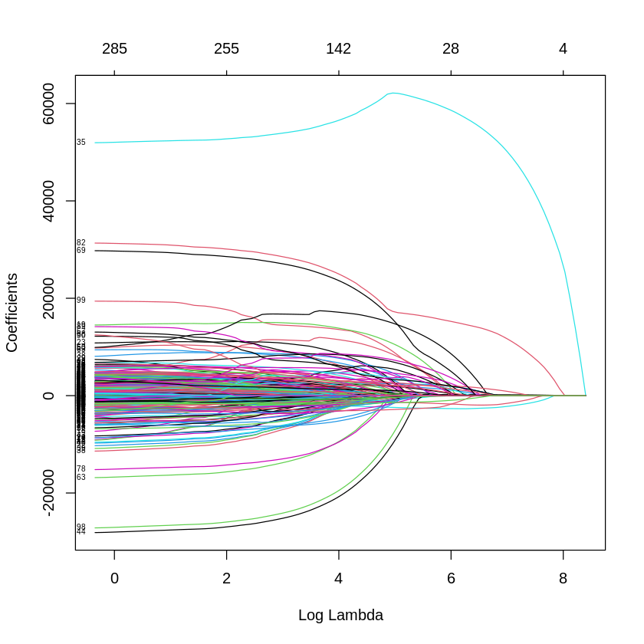
Ridge and Lasso
Test RMSE for OLS : 11938.486
Test RMSE for Ridge: 7155.59
Test RMSE for Lasso: 7195.74
Notes:
After performing OLS and then doing ridge and lasso and doing cross validation to find the lambda that decreases mse the greatest. By evaluating all models after using test mse, we can see that both models perform better than ols, this means they are able to trade off a large decrease in variance for a slight increase in bias.
The results for both ridge and lasso were very similar due their coefficients shrinking to reach approximately the same size. This means for both models there wasn’t a large penalty for the coefficients size.
We also were able to take use lasso to rank variables in term of predictive power, starting with the largest lambda and going down we were able to see the features pop up. The ranking are
Rankings of predictive power: km, power PS, year of registration, and gearbox
Yifang will talk about the regression tree

Slide 18
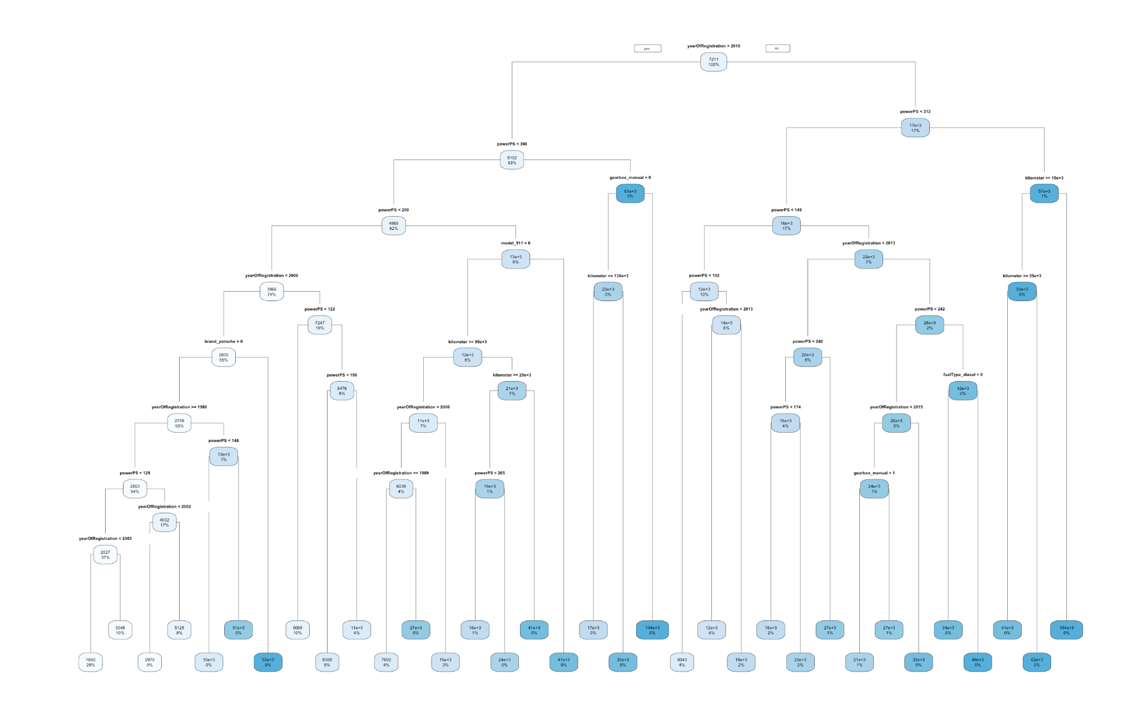
Regression Tree
Notes:
We can see that the two most important variables are year of registration and powerPS, which is the horsepower.
Now, imagine that we have a used car that we want to sell. This car is not a Porsche, the powerPS is lower than 129 and the year of registration is between 2003 to 2006. Then this used car can sell for about 3,048 dollars.
But if you own a Porsche car with year of registration before 2006 and powerPS lower than 200, then your car can be sold for 55,000 dollars

Slide 19
42,536,188
6,521.977
Regression Tree
MSE Train
MSE Test
135,081,915
RMSE Train
RMSE Test
11,622.47

Slide 20
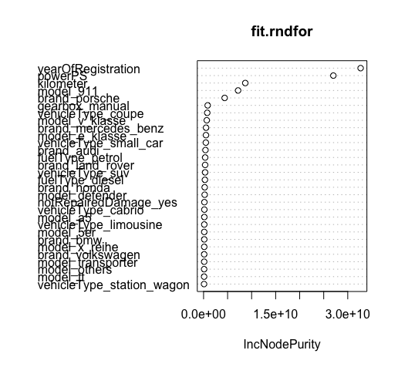
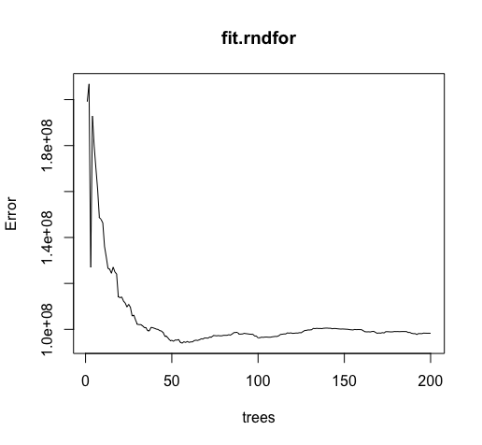
Random Forest
Predictor Importance
OOB Error
Notes:
We can see that OOB Error converges in after 50 iteration of trees. The most important features are YearofRedistration, PowerPS, and Kilometer. Train RMSE is 2091.875, and the Test RMSE is 4913.075, which has huge improvement compare to previous models.

Slide 21
Random Forest
Train RMSE: 2091.875
Test RMSE: 4913.075

Slide 22
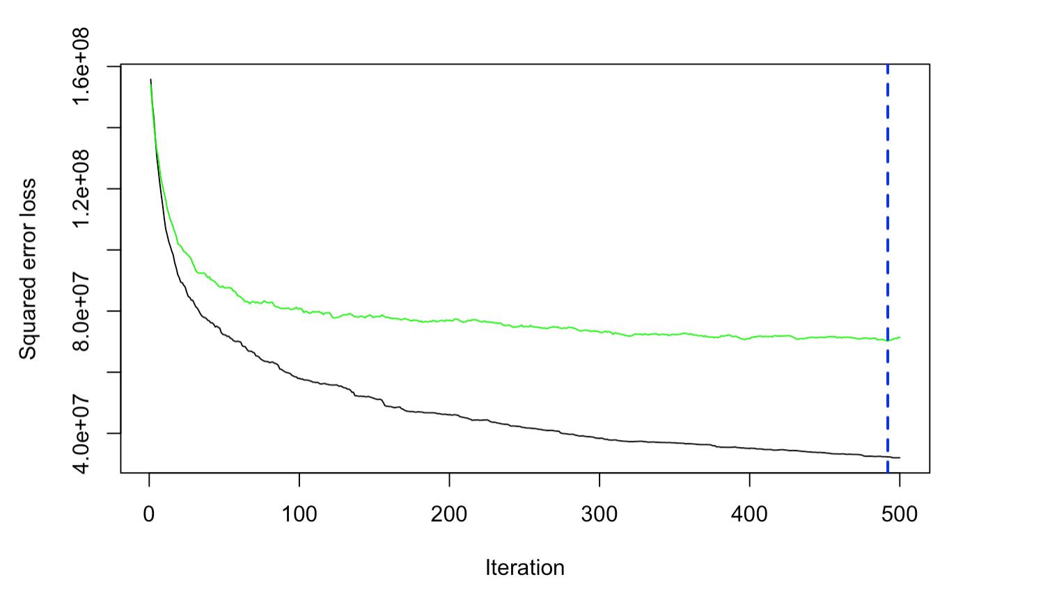
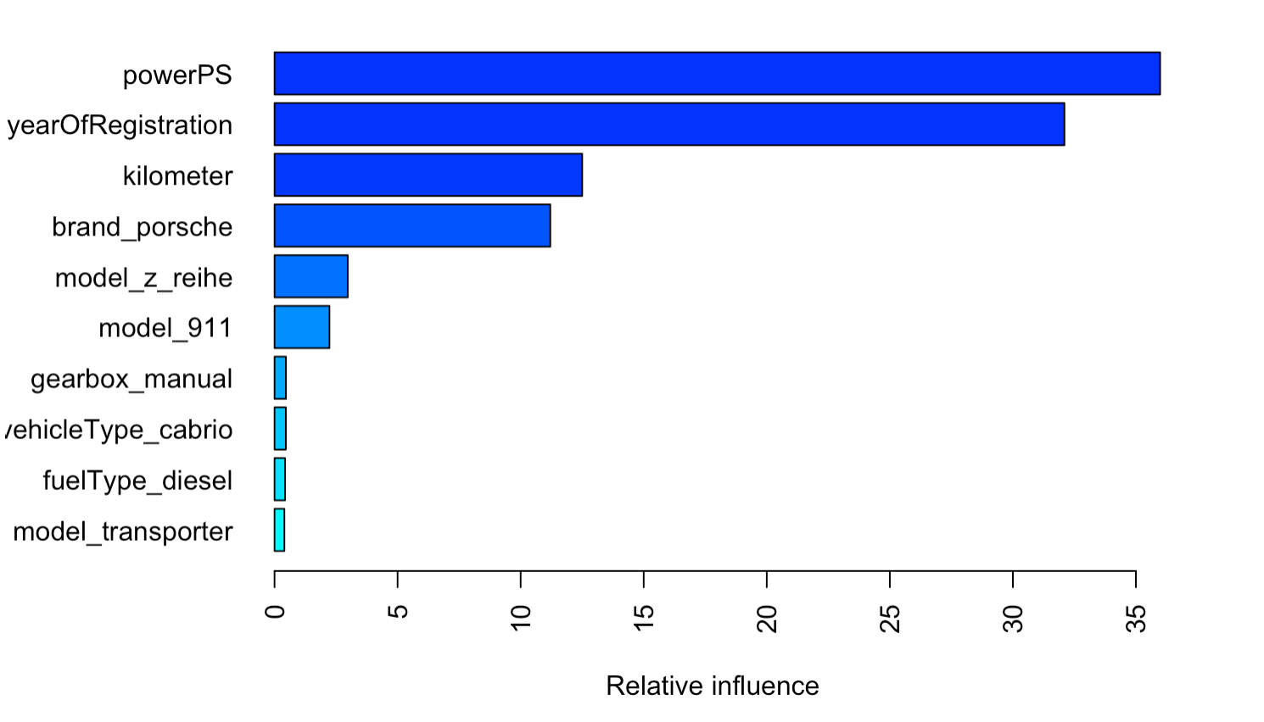
Boosting
Min Test RMSE: 8379.893
Notes:
For boosting we tried to tune the model for 100 trees and 500 trees, and we plot a loss function of n trees added to the model. Based on the plot we can see that the optimal iteration with minimum cross-validation error when we run the model with 500 trees occurs when n.tree is 496 with RMSE around 8000K. Also we found that powerPS, year Of Registration and kilometer are the most relative influence variables

Slide 23
MSE Comparisons
OLS
Ridge
Lasso
RMSE Train : 9609.137
RMSE Test : 11938.49
RMSE Train : 11442.35
RMSE Test : 7155.59
RMSE Train : 11426.85
RMSE Test : 7195.74
Regression Tree
Random Forests
GBM
Boosting
RMSE Train : 6521.98
RMSE Test : 11622.47
RMSE Train : 2091.875
RMSE Test : 4913.075
RMSE Train : 12395.44
RMSE Test : 8379.893
Notes:
Random Forests and GBM Boosting performed the best
Relationship between features and target is not linear
Ensemble method -> eliminates variance

Slide 24
04
Conclusion
Notes:
In summary, we implemented different ML algorithms to predict price used car prices on ebay for the purpose of providing guidance for future buyers and sellers.
According to our EDA, we learned that some patterns and relationships exist among the the features we’ve chosen to our price target variable. For instance, we saw that SUVs tend to have higher median price because they have lower depreciation compared to more common types of cars.
Comparing our test MSEs, Random Forests performed the best, followed by GBM Boosting, Ridge and Lasso, then OLS. Thus, we can see that the ensemble methods worked best with our dataset since our features do not have a linear relationship with our target variable.

Slide 25
Our biggest challenge
Notes:
Struggled with making our codes work together in R markdown
Different results but after setting seed problem solved

Slide 26
THANKS
Do you have any questions?

